Slide 1

Enhancing the Accuracy of Inauthentic Review Detection using Machine Learning and Sentiment Analysis
Author: Teresa Quain

Slide 2
Problem Statement
Inauthentic online reviews are increasingly common and pose issues for consumers and businesses
Customers rely on reviews for decision making, safety, product quality information etc.
Fake positive reviews mislead customers, harm businesses' reputations and revenues
Needed improved computational methods to accurately detect fake reviews

Slide 3
Hypothesis & Research Objectives
AI can detect online reviews which are not left by a genuine consumer, by using natural language processing techniques and or machine learning
1. Classify online review dataset with NLP techniques like, sentiment analysis, entity identification, Semantic analysis
2. Develop and implement rule-based classification system to detect review authenticity
3. Generate machine learning models and compare performance to rule-based system for accuracy

Slide 4
Methodology
Univariate analysis (histograms, word clouds)
Bivariate analysis (heatmaps, count plots, bar charts)
1328 Google Maps restaurant reviews from Dublin & Galway sourced from outscraper.com
EXPLORATORY DATA ANALAYSIS
DATASET
Text cleaning
Stop word removal
Punctuation
Sentiment analysis
Entity identification
PREPROCESSING
ML MODELLING
RULE BASED CLASSIFICATION
Supervised (Multinomial nb, sgd classifier, linear svc)
Unsupervised compared(K-Means clustering)
7 linguistic rules based on literature review research

Slide 5
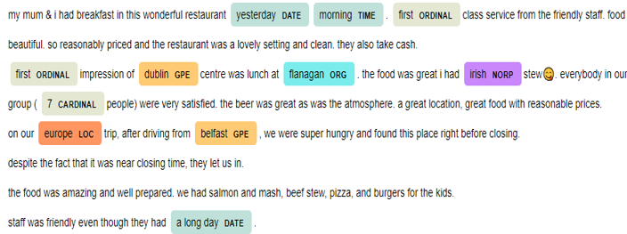
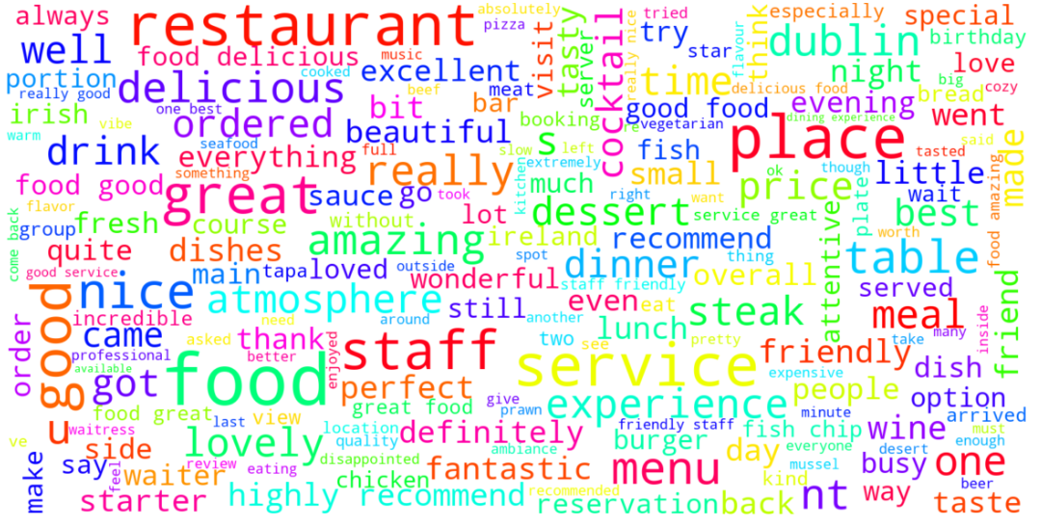
Data Visualizations

Slide 6
Key Results
PREPROCESSING
High positive sentiment is directly correlated to the star rating and the num. of review likes
Word clouds showed most frequented words are food, service, staff and Delicious. This suggest that the quality of the food and the service in the restaurant from staff are important to customers
Review likes is positively correlated to character count indicating other reviewer appreciate a longer review with more detail
Rule based classification
Rule-based flagged 294 as inauthentic, 1034 authentic (28%)
Machine learning Modelling
Supervised ML model accuracy 0.87, ROC/AUC 0.5
Unsupervised ml found clusters 1,3 to have more flags for inauthenticity than clusters 0,2,4
Appendices
Interviews confirmed inauthentic review issue for businesses

Slide 7
Summary
Online fake reviews a growing issue that misleads customers
Research aimed to improve detection accuracy with ML & NLP
Implemented and evaluated Rule-based Classification and ML models
Demonstrated feasibility but needs more data and model validation and further consultation with businesses to determine specific client needs

Slide 8

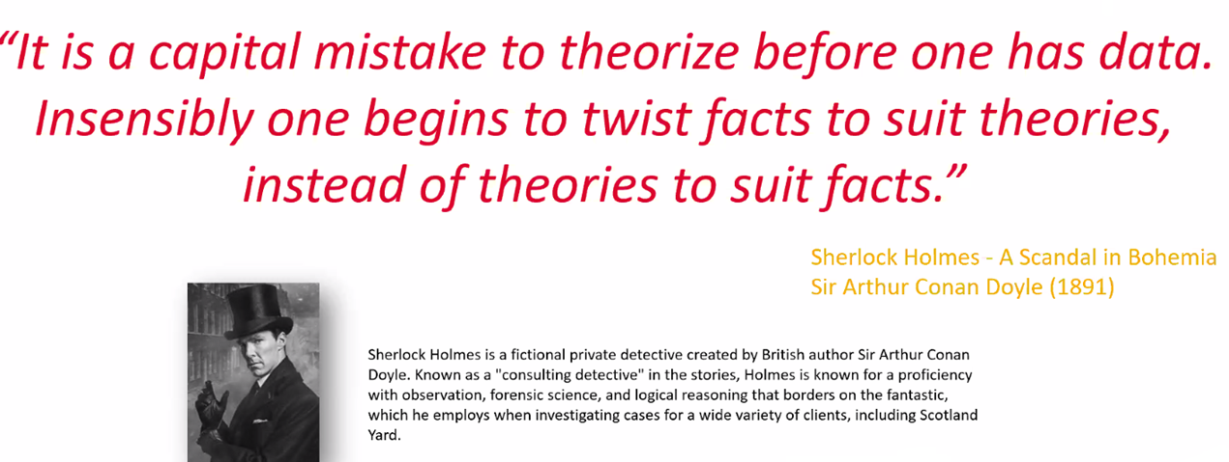
Thank You
Any Questions?

